Slide 1
Understanding Release Planning
Ravi Shekhar
17th Nov 2021

Slide 2
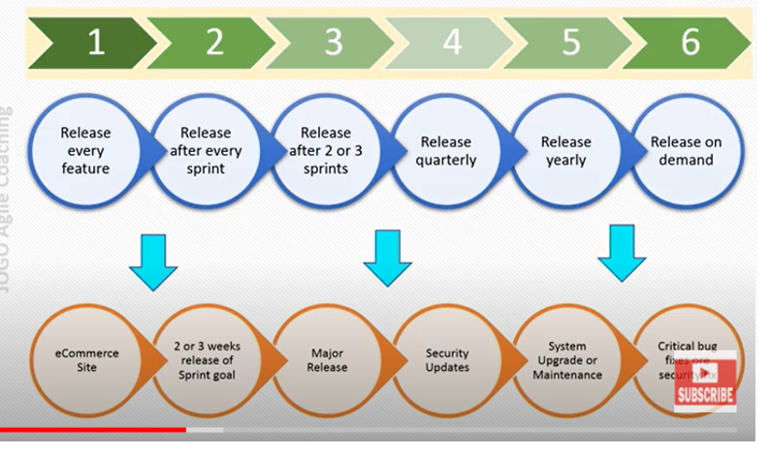
Release Type in Agile Projects

Slide 3
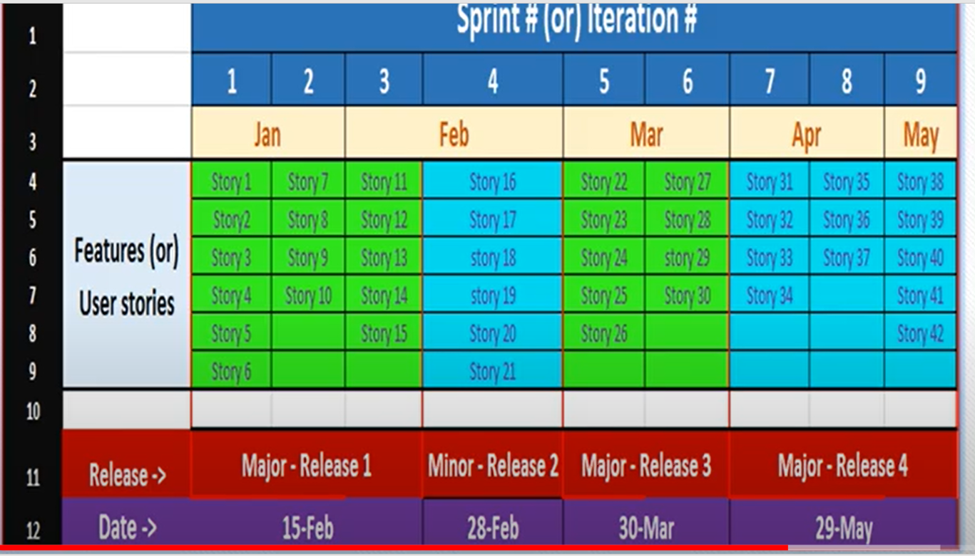
Agile Project Release format 1

Slide 4
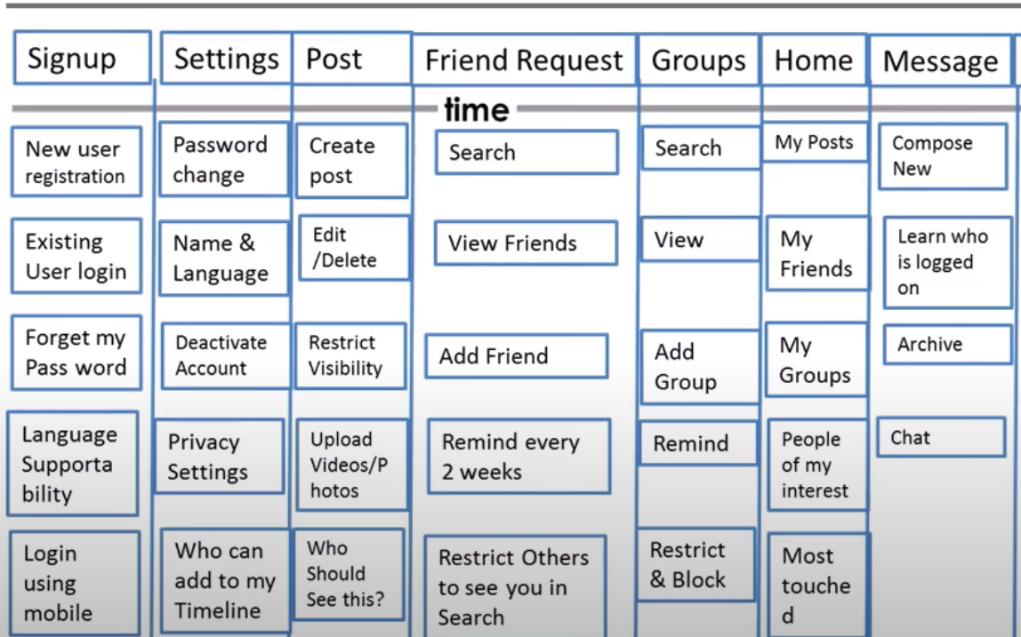
Features and Stories Mapping
Feature
Stories

Slide 5
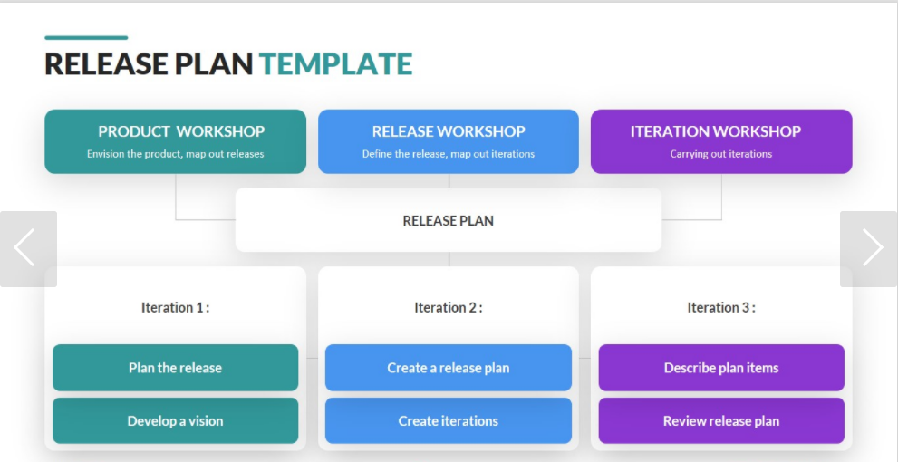
Release plan Development Process

Slide 6
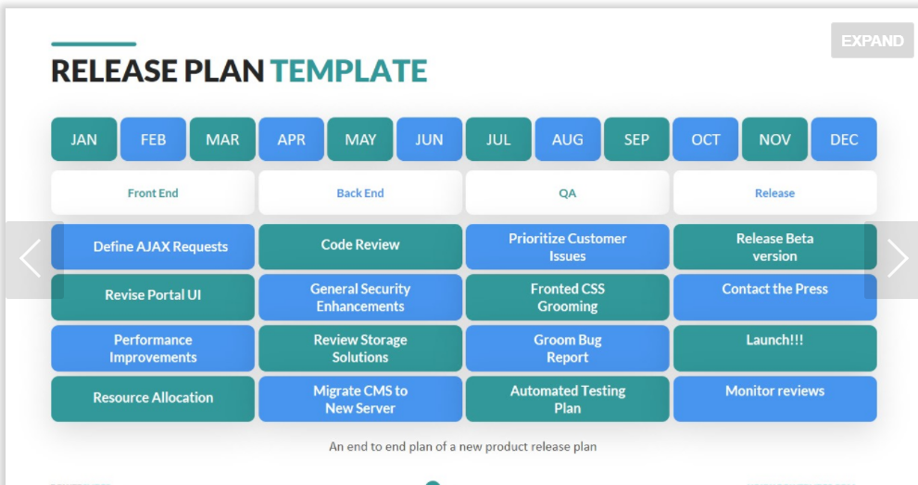

Slide 7
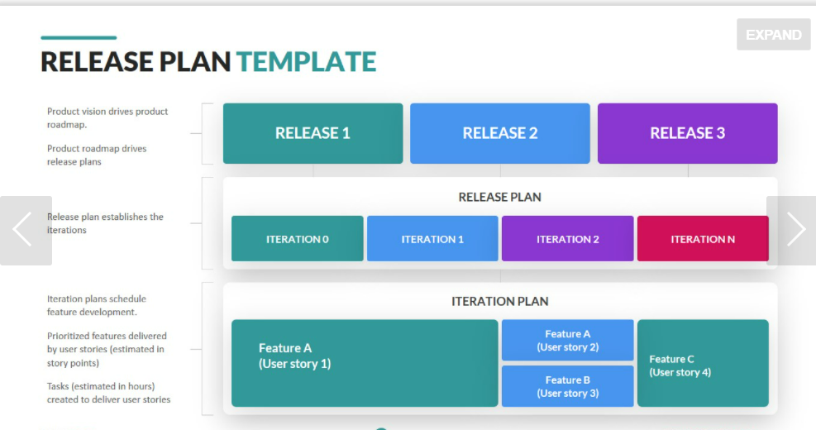

Slide 8
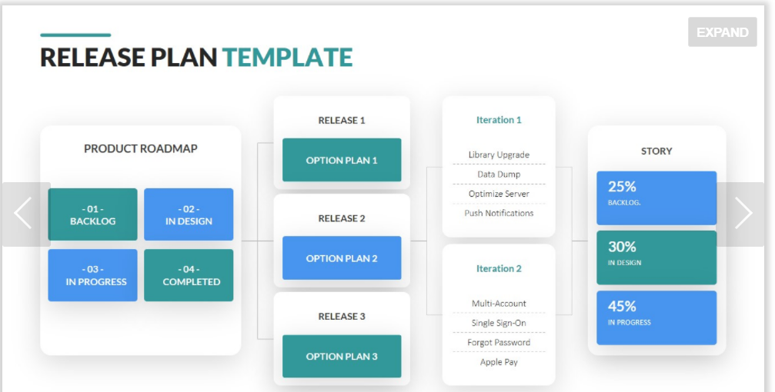

Slide 9
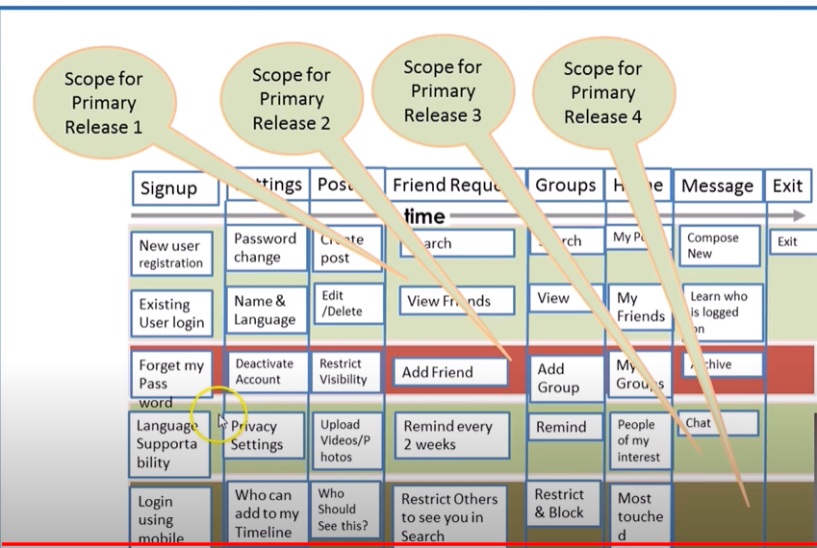

Slide 10
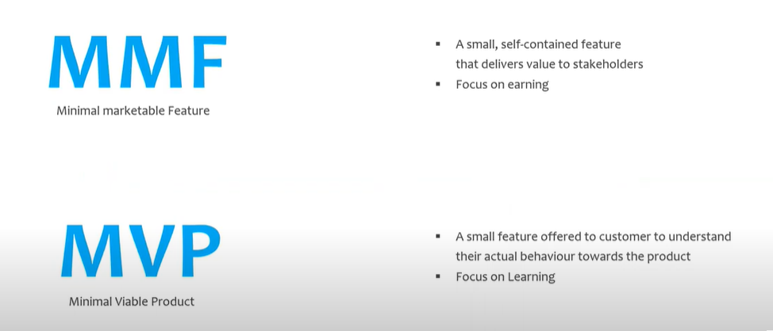
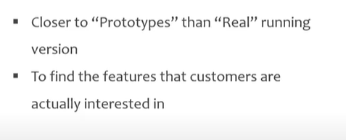
MMF and MVP

Slide 11
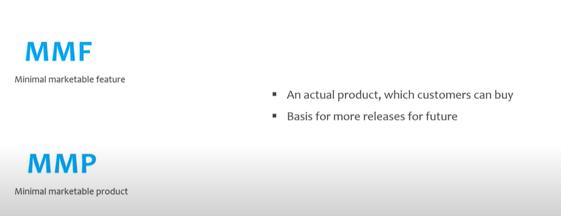
MMF and MVP

Slide 12
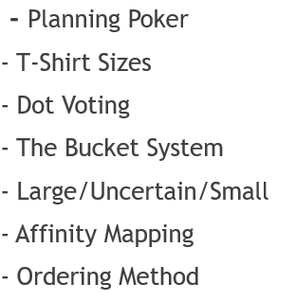
Estimation Techniques
- Story Points Estimation

Slide 13
Story Points Estimation
Select the Reference Story
Analyze the Complexities, Gaps/Issue/Risk/Uncertainty and Size of the work
Assign Modified Fibonacci number is assigned 0,1,2,3,5,8,13,20,40 and 100.
All other stories are estimated with respect this stories

Slide 14

Planning Poker

Slide 15
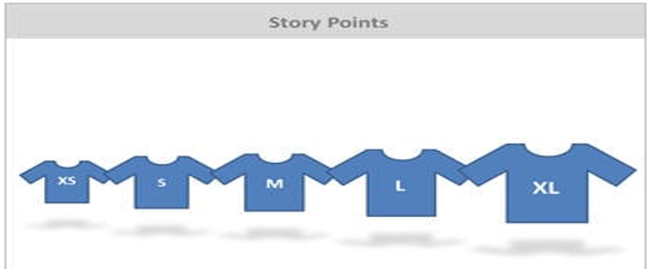
T Shirt Size

Slide 16
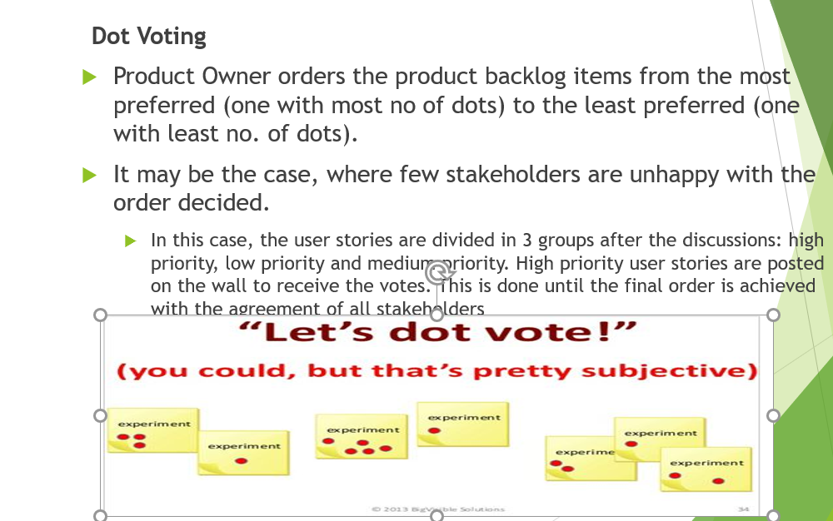
Dot Voting

Slide 17
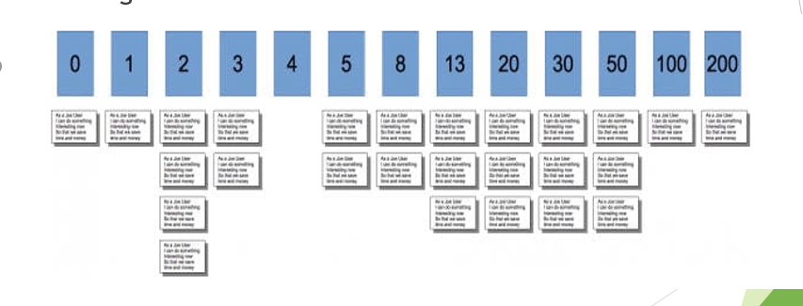
The Bucket System

Slide 18
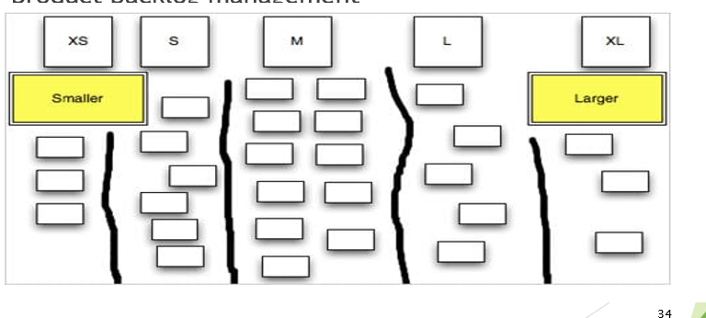
Affinity Mapping

